Slide 2


Slide 3
Modelling of Power Consumption
Model Validation
Model Combination

Slide 4
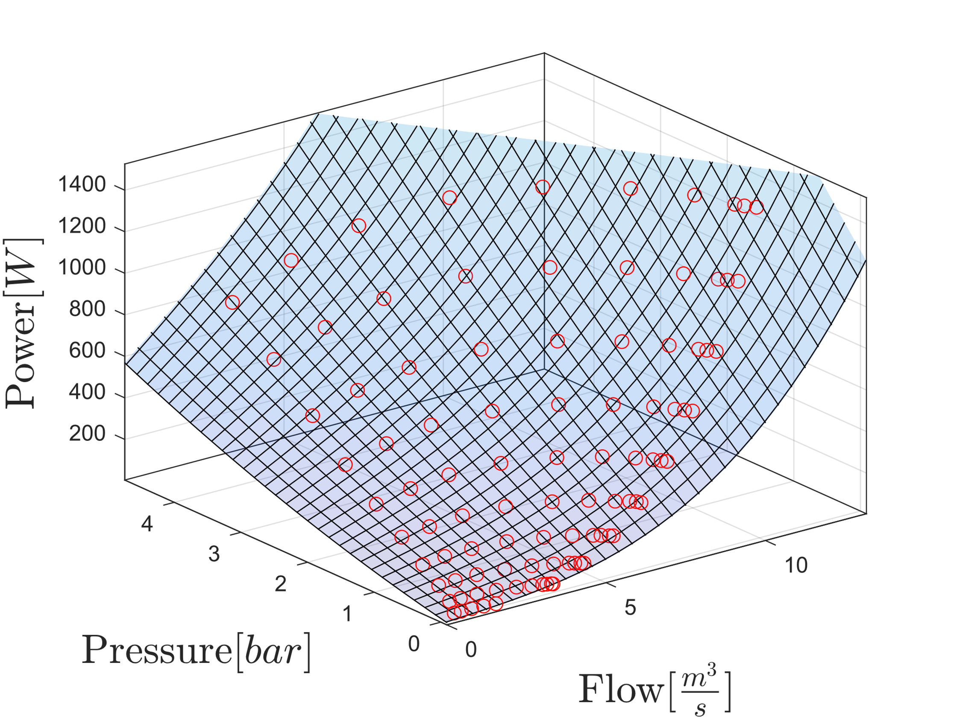
Power consumption
Model for single pump

Slide 5
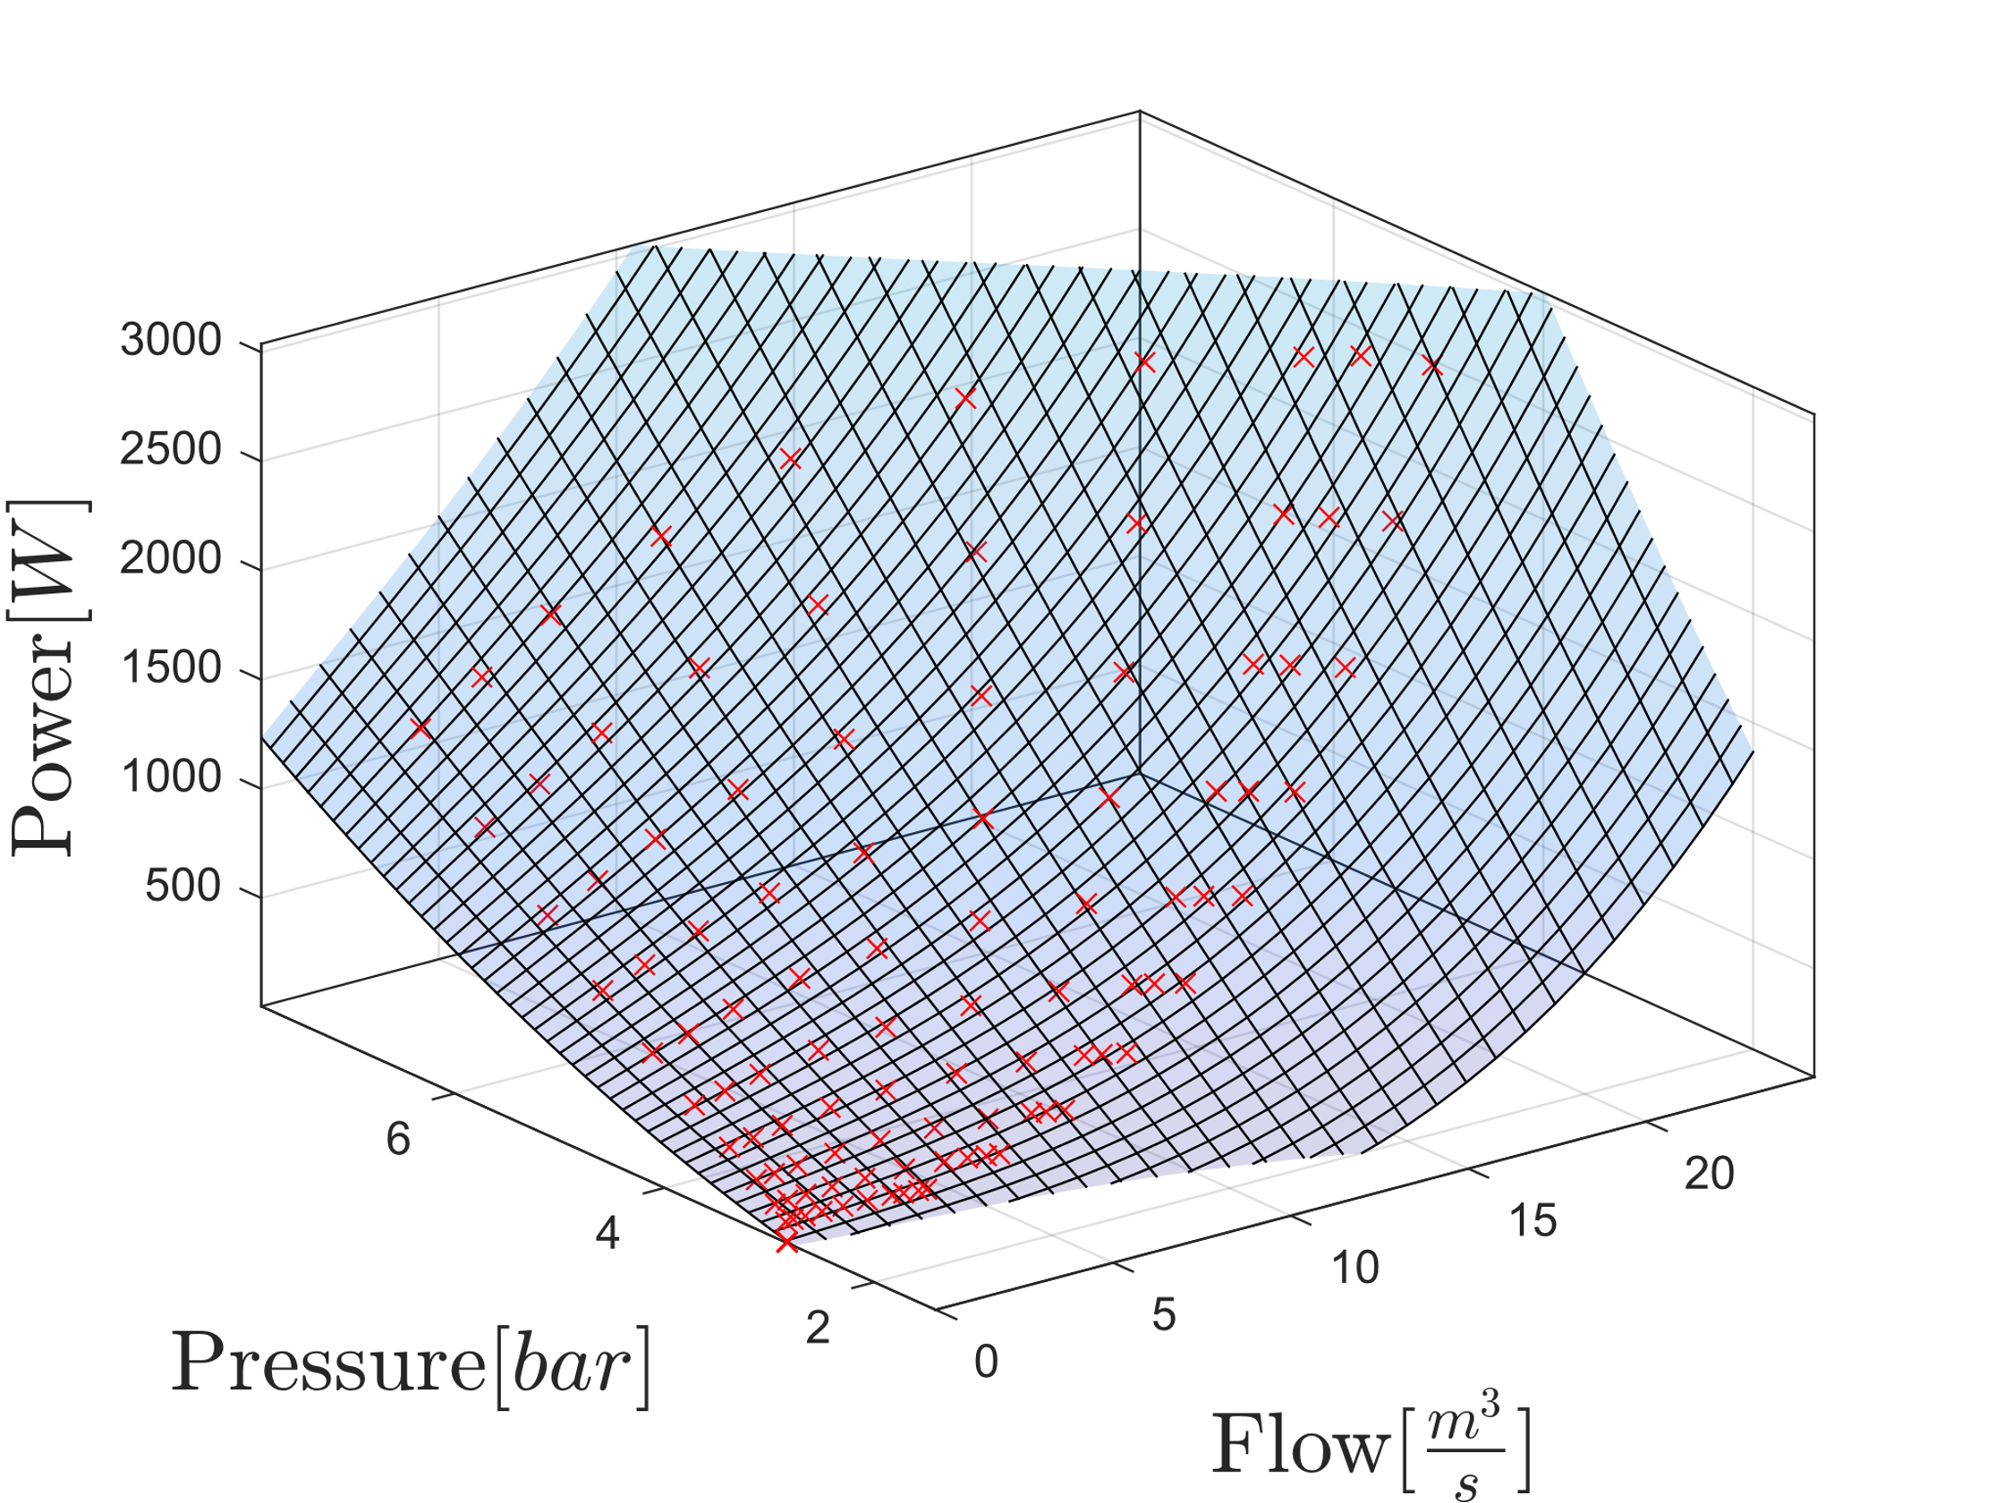
Power consumption
Model for two pumps

Slide 6
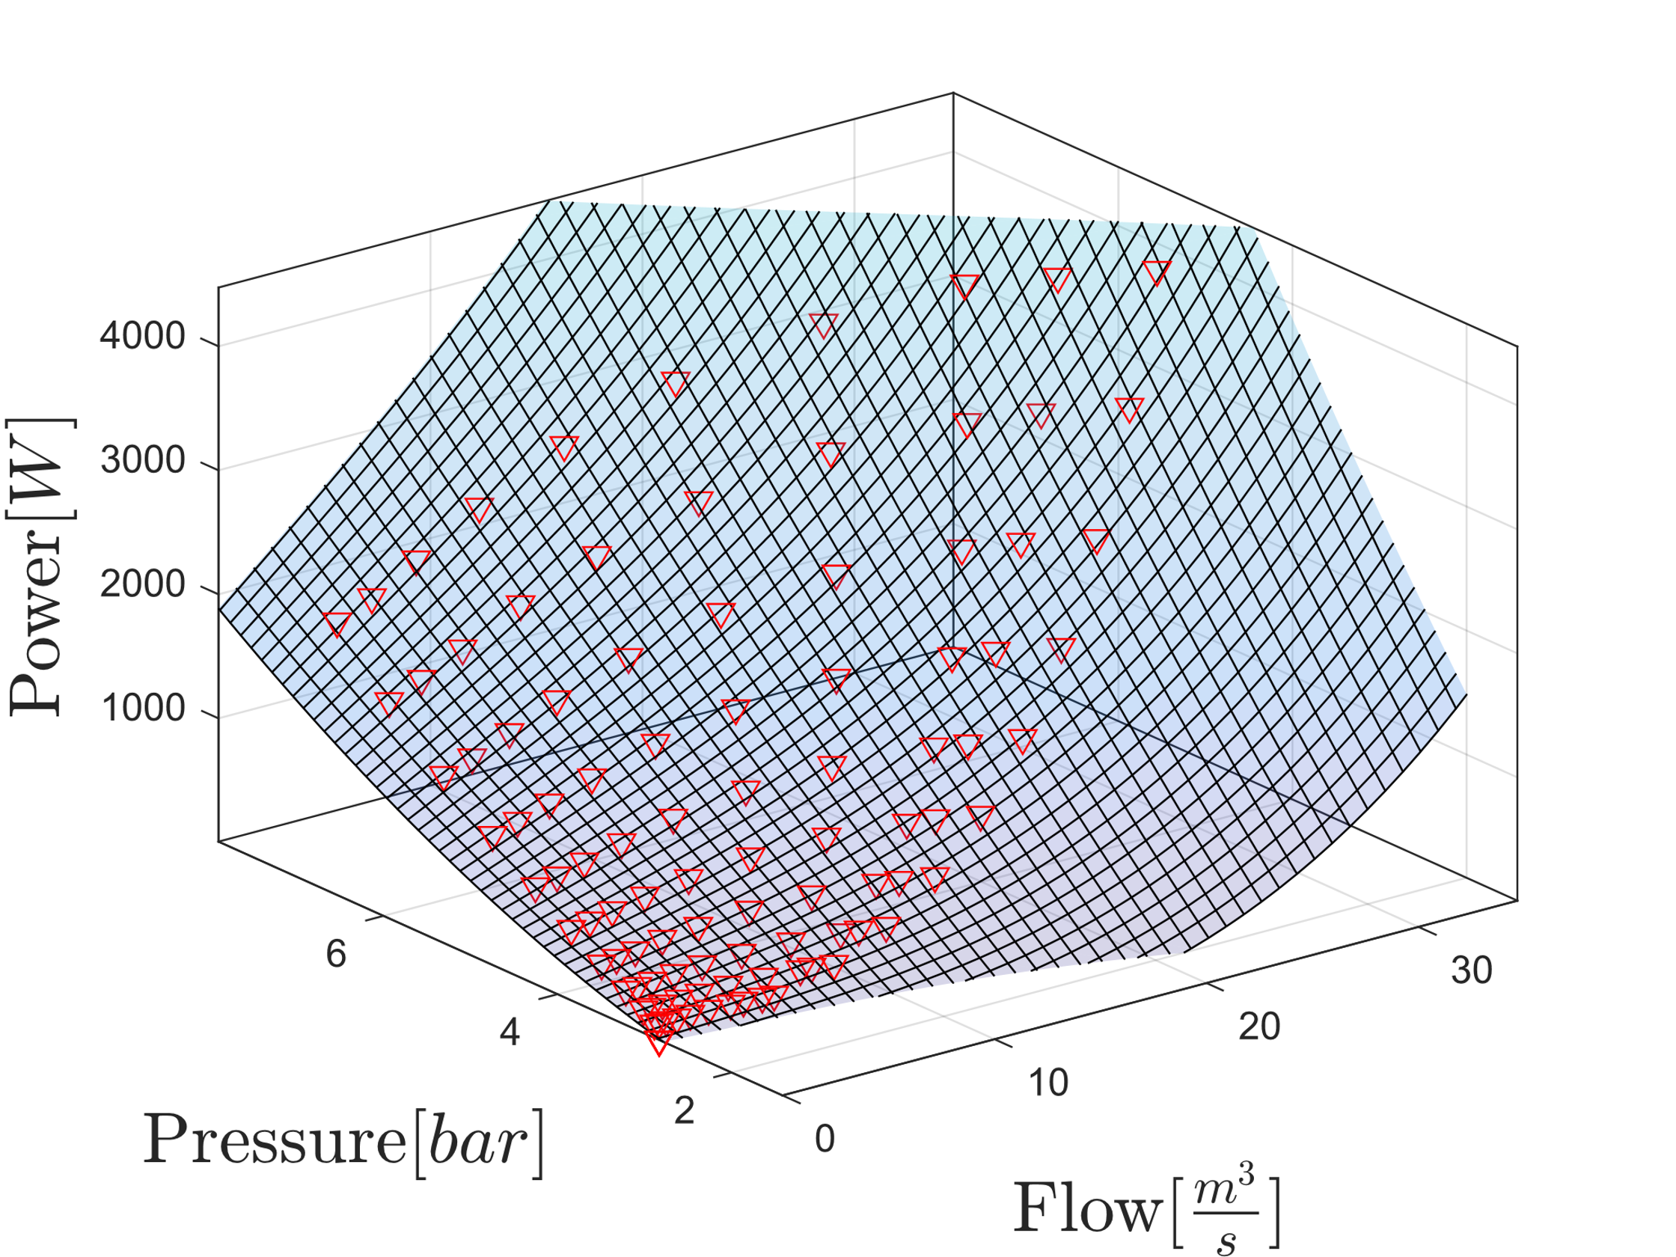
Power consumption
Model for three pumps

Slide 7
Model Validation
Validation for one pump

Slide 8
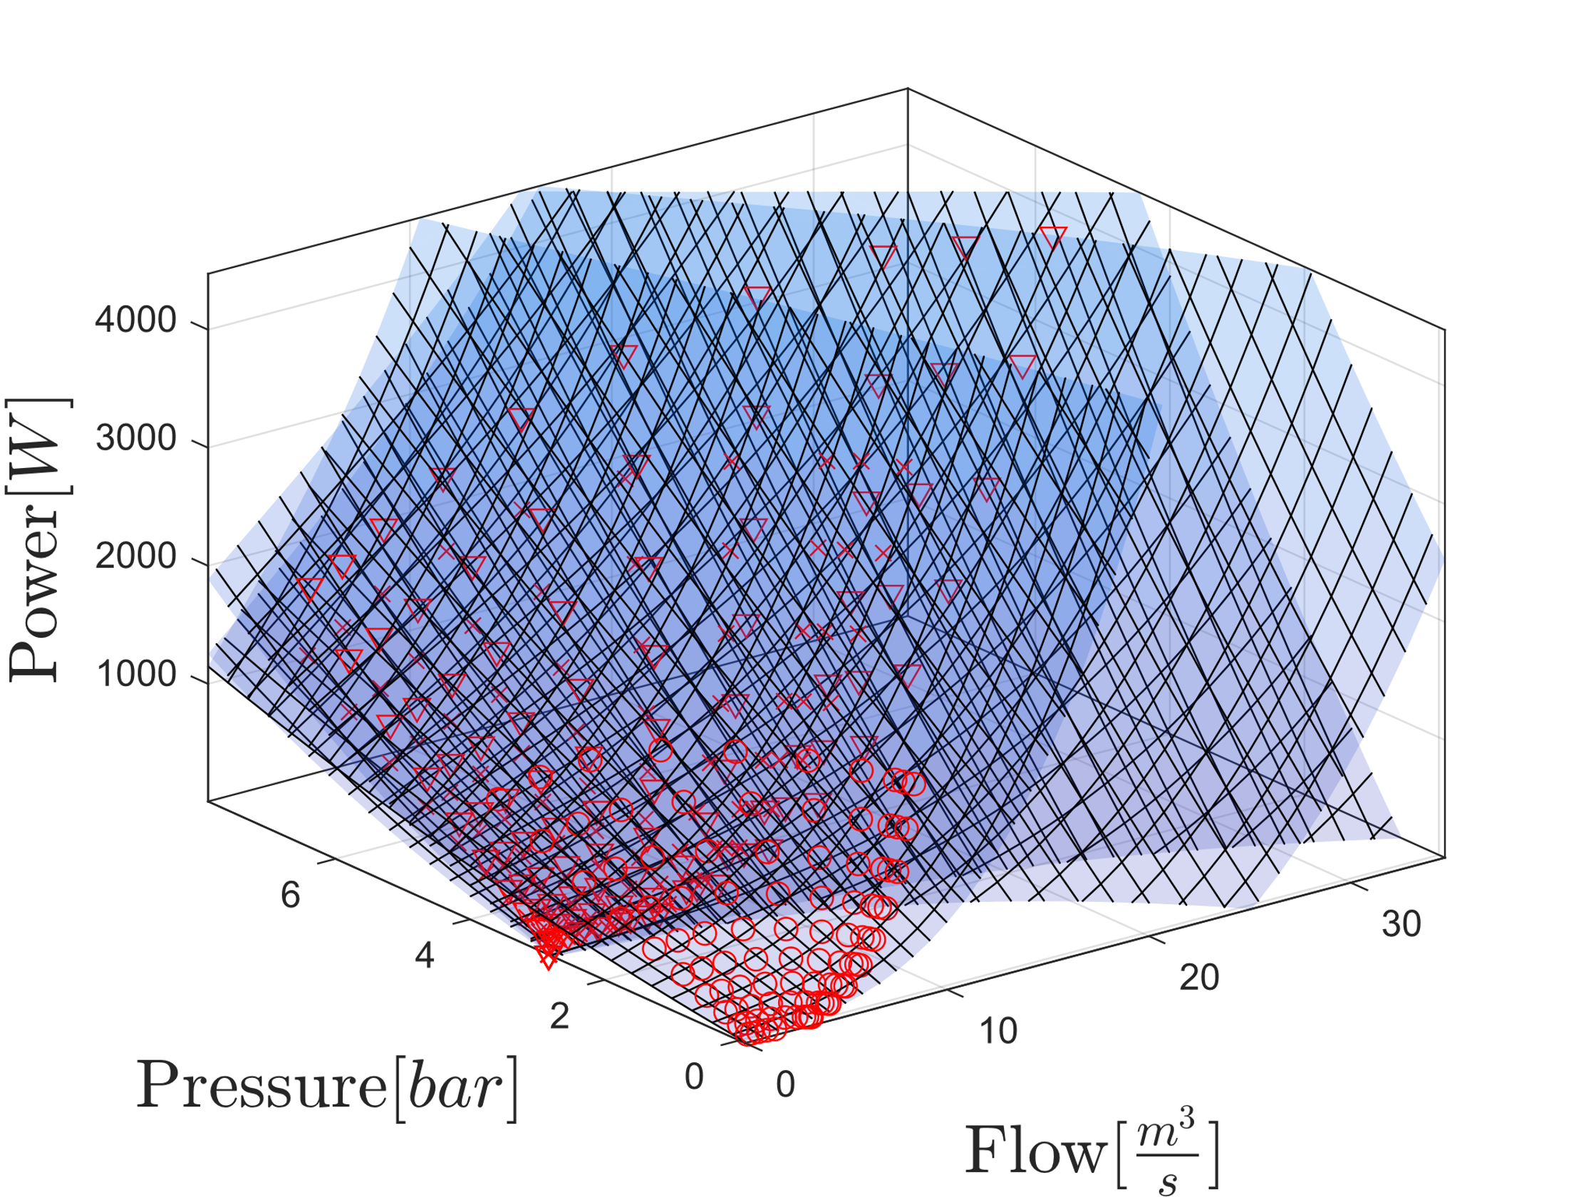
Power consumption
Combined Model

Slide 9
